Slide 1
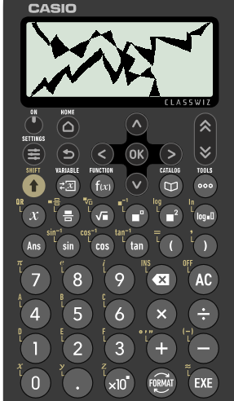
Divisibility tests for 2 and 3
Task A: Any even number is a multiple of 2
Using a test of divisibility by 2, identify all the multiples of 2 from the list below:
3 284 738
2 478 349
999 111 333
445 534
390
1115
222 222 222
2) Izzy’s calculator has broken.
She knows the number on the screen :
is a multiple of 2
has exactly 5 tens
is a 4 digit number
is greater than 8600
Less than 8660
What could her number be?

Slide 2

Divisibility tests for 2 and 3
Task B: Divisibility tests for multiples of 3
1a) Identify all the multiples of 3 from the list.
234, 1398, 20 495, 593, 56 576
1b) Identify all the multiples of 2 and 3 from the list.
325, 139, 120 490, 594, 656 578 452
2) Here are five cards, each with a digit.
Only using 4 cards,
make a 4 digit number which is a multiple of 3.
make a 4 digit number which is a multiple of 3 and 2.

Slide 3
Divisibility tests for 2 and 3
Task B: Divisibility tests for multiples of 3
3) Using the numbers below, fill in the Venn diagram.
248 4343 4350 312 492 892 091
111 7 77 555 555
Multiples of 2
Multiples of 3
4) Here is an integer with a lot of digits.
999 898 969 698 751 986
Using the divisibility test, how do you show this is a multiple of 3?
Mathematics in Education and Industry
v2.1

